Slide 1
Methods and Parameters
Methods Declarations
Method Signatures
Method Overloading
The “this” Reference
Visibility Modifiers
Mutators/Setters and Accessors/Getters

Slide 2
Method Declarations
Let’s now examine method declarations in more detail
A method declaration specifies the code that will be executed when the method is invoked (called)
When a method is invoked, the flow of control jumps to the method and executes its code
When complete, the flow returns to the place where the method was called and continues
The invocation may or may not return a value, depending on how the method is defined

Slide 3
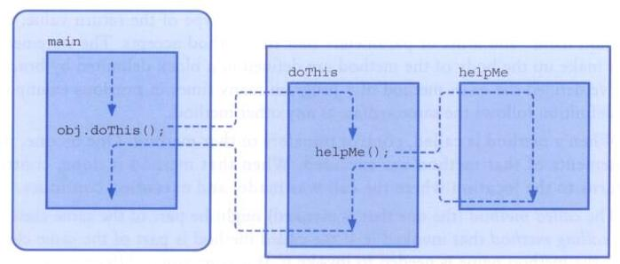
Methods
The flow of control through methods:

Slide 4
Method Header
A method declaration begins with a method header (aka method signature)
char calc (int num1, int num2, String message)
method
name
parameter list
return
type
The parameter list specifies the type
and name of each parameter

Slide 5
Method Body
The method header is followed by the method body
char calc (int num1, int num2, String message)
{
int sum = num1 + num2;
char result = message.charAt (sum);
return result;
}
num1, num2, message, sum and result
are local data
They are created each time the method is called, and are destroyed when it finishes executing
The return expression
must be consistent with
the return type

Slide 6
The return Statement
The return type of a method indicates the type of value that the method sends back to the caller
A method that does not return a value has a void return type
A return statement specifies the value that will be returned
return expression;
Its expression must conform to the return type
Returns can be placed with if statements but every execution path must have a return if the method is not void

Slide 7
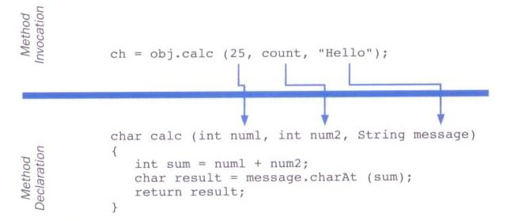
Parameters
When a method is called, the actual parameters in the invocation are copied into the formal parameters in the method header

Slide 8
The this reference
The this reference can be used to distinguish the instance variables of a class from corresponding method parameters with the same names
The constructor of the Account class could have been written as follows:
public Account (String name, long acctNumber,
double balance)
{
this.name = name;
this.acctNumber = acctNumber;
this.balance = balance;
}

Slide 9
Method Overloading
Method overloading is the process of giving a single method name multiple definitions
If a method is overloaded, the method name is not sufficient to determine which method is being called
The signature of each overloaded method must be unique
The signature includes the number, type, and order of the parameters

Slide 10
Method Overloading
The compiler determines which method is being invoked by analyzing the parameters
float tryMe(int x)
{
return x + .375;
}
Invocation
result = tryMe(25, 4.32)
float tryMe(int x, float y)
{
return x * y;
}

Slide 11
Method Overloading
The return type of the method is not part of the signature
That is, overloaded methods cannot differ only by their return type
Constructors can be overloaded
Overloaded constructors provide multiple ways to initialize a new object

Slide 12
Visibility Modifiers
In Java, we accomplish encapsulation through the appropriate use of visibility modifiers
A modifier is a Java reserved word that specifies particular characteristics of a method or data
We've used the final modifier to define constants
Java has three visibility modifiers: public, protected, and private
The protected modifier involves inheritance and is not discussed here

Slide 13
Visibility Modifiers
Members of a class that are declared with public visibility can be referenced anywhere
Members of a class that are declared with private visibility can be referenced only within that class
Members declared without a visibility modifier have default visibility and can be referenced by any class in the same package

Slide 14
Visibility Modifiers
Public variables violate encapsulation because they allow the client to “reach in” and modify the values directly
Therefore instance variables should not be declared with public visibility
It is acceptable to give a constant public visibility, which allows it to be used outside of the class
Public constants do not violate encapsulation because, although the client can access it, its value cannot be changed

Slide 15
Accessors and Mutators
Because instance data is private, a class usually provides services to access and modify data values
An accessor method (getter) returns the current value of a variable
A mutator method (setter) changes the value of a variable
The names of accessor and mutator methods usually take the form getX and setX, respectively, where X is the name of the value

Slide 16
Accessors and Mutators
In the Coin class
The isHeads method is an accessor
The flip method is a mutator
public class Coin
{
private final int HEADS = 0; // tails is 1
private int face; // current side showing
public Coin()
{
flip();
}
public void flip()
{
face = (int) (Math.random() * 2);
}
public boolean isHeads()
{
if (face == HEADS)
return true;
else
return false;
}
}

Slide 17
public class CountFlips
{
//-----------------------------------------------------------------
// Flips a coin multiple times and counts the number of heads
// and tails that result.
//-----------------------------------------------------------------
public static void main(String[] args)
{
final int FLIPS = 1000;
int heads = 0, tails = 0;
Coin myCoin = new Coin();
for (int count=1; count <= FLIPS; count++)
{
myCoin.flip();
if (myCoin.isHeads())
heads++;
else
tails++;
}
System.out.println("Number of flips: " + FLIPS);
System.out.println("Number of heads: " + heads);
System.out.println("Number of tails: " + tails);
}
}

